Slide 1
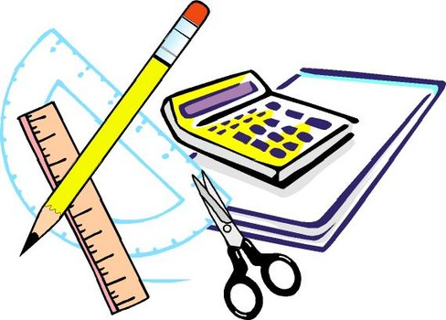
Learning Objective
I will solve probability problems with dependent and independent events
Enter quietly, please be ready with the following on your desk:
Whiteboard
Whiteboard marker
Exercise Book
Pencil, pen, ruler and red pen
Diary
Calculator
Device – charged or borrowed from Library before maths

Slide 2
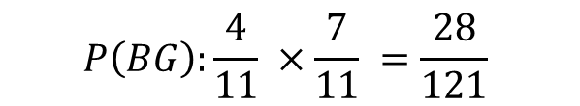
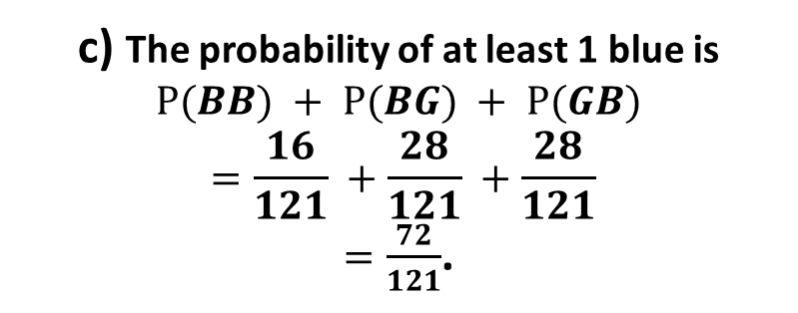

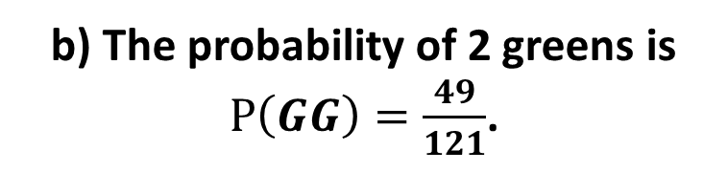
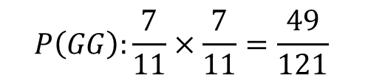

Daily Review
A marble is taken from a bag containing 4 blue marbles and 7 green marbles. It is replaced and then a 2nd marble is taken out.
Draw a tree diagram that represents this situation
Find the probability of getting two green marbles.
Find the probability of getting at least one blue marble.
‘with replacement’
<
1st
2nd
b) The probability of 2 greens is
$P\left(GG\right)=\frac{49}{121}$.
<
$$P\left(BB\right):\frac{4}{11}×\frac{4}{11} =\frac{16}{121}$$
B
4/11
4/11
B
<
G
$$P\left(BG\right):\frac{4}{11} ×\frac{7}{11} =\frac{28}{121}$$
7/11
c) The probability of at least 1 blue is
$$P(BB) + P⁡(BG) + P⁡(GB)$$
$$=\frac{16}{121} +\frac{28}{121} +\frac{28}{121}$$
$=\frac{72}{121}$.
B
$$P\left(GB\right):\frac{7}{11} ×\frac{4}{11} =\frac{28}{121}$$
4/11
7/11
G
7/11
G
$$P\left(GG\right):\frac{7}{11}×\frac{7}{11}=\frac{49}{121}$$

Slide 3

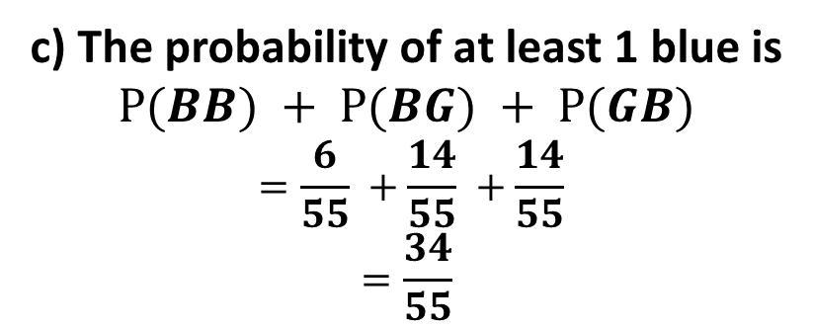

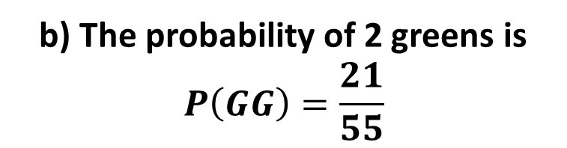

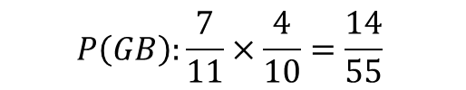
Daily Review
A marble is taken from a bag containing 4 blue marbles and 7 green marbles. It is not replaced before a 2nd marble is taken out.
a) Draw a tree diagram with probabilities to represents this situation.
b) Find the probability of getting two green marbles.
c) Find the probability of getting at least one blue marble.
<
1st
2nd
<
b) The probability of 2 greens is
$$P\left(GG\right)=\frac{21}{55}$$
$$P\left(BB\right):\frac{4}{11} ×\frac{3}{10} =\frac{6}{55}$$
B
3/10
4/11
B
<
G
$$P\left(BG\right):\frac{4}{11}×\frac{7}{10} =\frac{14}{55}$$
7/10
c) The probability of at least 1 blue is
$$P⁡(BB) + P⁡(BG) + P⁡(GB)$$
$$=\frac{6}{55} +\frac{14}{55} +\frac{14}{55}$$
$$=\frac{34}{55}$$
B
$$P\left(GB\right):\frac{7}{11}×\frac{4}{10}=\frac{14}{55}$$
4/10
7/11
G
6/10
G
$$P\left(GG\right):\frac{7}{11}×\frac{6}{10}=\frac{21}{55}$$

Slide 4
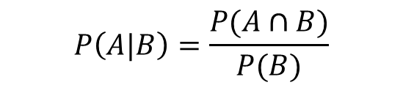

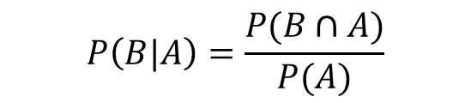

Daily Review
A 16-sided die with faces numbered 1-16 is rolled. The following events are defined.
A= “number rolled is less than 9”, B = “number rolled is a multiple of 3”
Draw a venn diagram to represent the information
Calculate the probability when a number rolled is less than 9 given it is a multiple of 3
Calculate the probability when a number rolled is a multiple of 3, given that the number is less than 9.
$$P\left(A|B\right)=\frac{P(A∩B)}{P(B)}$$
$$=\frac{2}{5}$$
$$P\left(B|A\right)=\frac{P(B∩A)}{P(A)}$$
$$=\frac{2}{8}=\frac{1}{4}$$

Slide 5
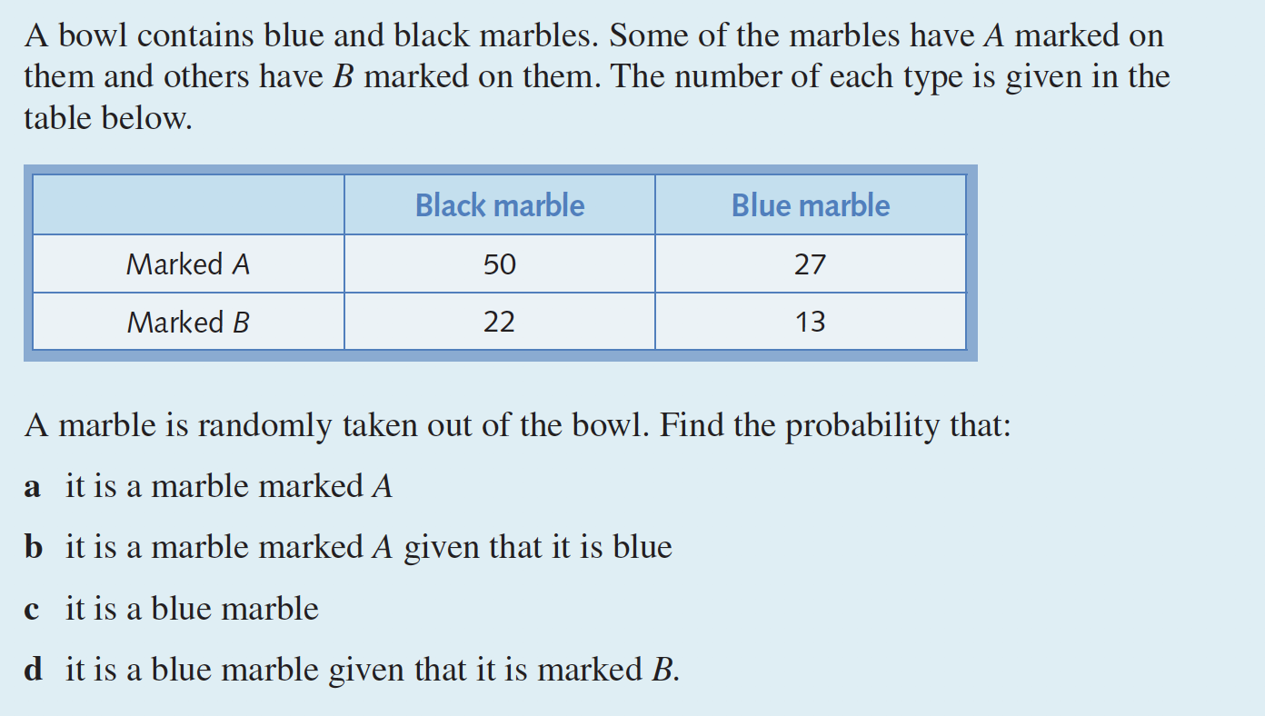
Daily Review

Slide 6
Learning Objective
CFU 1
What will we learn?
I will be able to solve probability problems with dependent and independent events
CFU 2
What will we learn?
Success Criteria
I will be able to
Differentiate between dependent and independent events
Calculate probabilities of events that are independent
Calculate probabilities of events that are dependent

Slide 7
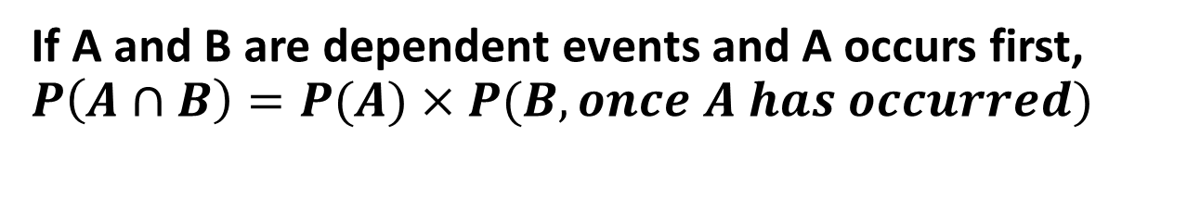
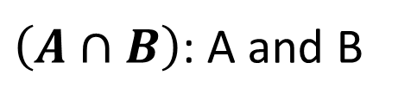
Concept Development
$\left(A∩B\right)$: A and B
Independent Events:
Events where the outcome of one event has no effect on the outcomes of the other
If A and B are independent events, $P\left(A∩B\right)=P(A)×P(B)$
Dependent Events:
Events where the outcome of one event does have an effect on the outcome of the other
If A and B are dependent events and A occurs first, $P\left(A∩B\right)=P(A)×P(B, once A has occurred)$

Slide 8





Vocabulary
$\left(tail ∩ 1\right)$ = $tail and 1$
Consider the situation where you spin a spinner with outcomes 1, 2 and 3, and toss a coin.
Represent the information in a two-way tables
Probability of getting a Tail
Probability of spinning a 1
Determine P(tail) x P(1)
Probability of tossing a tail and spinning a 1
b) $P\left(tail\right)=\frac{1}{2}$
c) $P\left(spinning 1\right)=\frac{1}{3}$
d) $P\left(tail\right)×P\left(1\right)=\frac{1}{2}×\frac{1}{3}=\frac{1}{6}$
e) $P\left(tail ∩ 1\right)=\frac{1}{6}$
Notice: $P\left(tail ∩ 1\right)=P(tail)×P(1)$
Tossing a Tail and Spinning a 1 are independent events

Slide 9


Concept development
On a desk, there sits a container of 5 black and 5 blue pencils, and a second container with 20 coloured pencils. The coloured pencils include 2 red, 4 purple, 3 green and 11 yellow.
What is the probability of selecting a black pencil from the first container?
What is the probability of selecting a red pencil from the second container?
Does the probability of selecting the black pencil affects the probability of selecting the red pencil?
Are the events independent or dependent? Why?
a) $P\left(black\right)=\frac{1}{2}$
b) $P\left(red\right)=\frac{2}{20}=\frac{1}{10}$
c) No
d) Independent. The outcomes of one event does not affect the outcome of the other

Slide 10
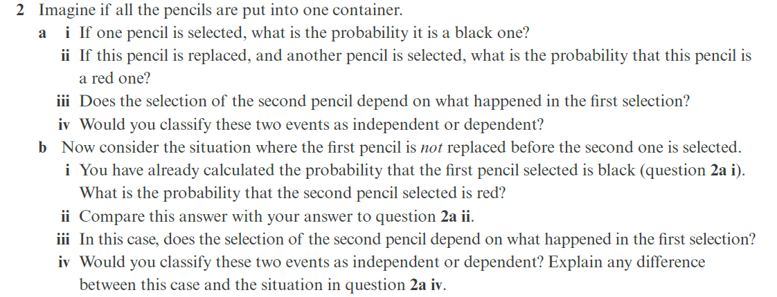
Concept development
We now combine all the pencils into one container. There are now 5 black, 5 blue pencils, 2 red, 4 purple, 3 green and 11 yellow pencils
What is the probability of selecting a black pencil?
If this pencil is replaced, and another pencil is selected, what is the probability that this pencil is a red one?
Does the selection of the second pencil depend on what happened in the first selection?
Would you classify these two events as independent or dependent?
a) $P\left(Black\right)=\frac{5}{30}=\frac{1}{6}$
b) $P\left(red\right)=\frac{2}{30}=\frac{1}{15}$
c) No
d) Independent.

Slide 11
Concept development
Now consider the situation where the first pencil is not replaced before the second is selected.
What is the probability of selecting a black pencil?
Another pencil is selected, what is the probability that this pencil is a red one?
Does the selection of the second pencil depend on what happened in the first selection?
Would you classify these two events as independent or dependent? Why?
a) $P\left(Black\right)=\frac{5}{30}=\frac{1}{6}$
b) $P\left(red\right)=\frac{2}{29}$
c) Yes
d) Dependent because the second event outcome is dependent on the first.

Slide 12
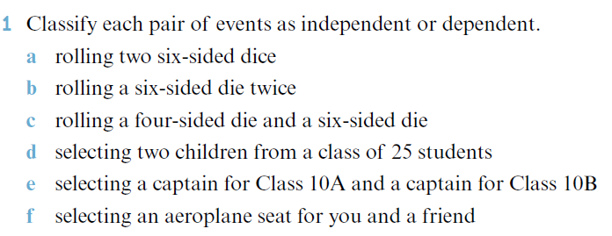
Guided Practice

Slide 13
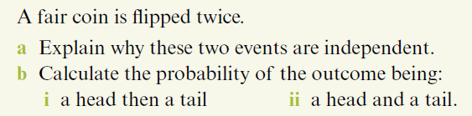
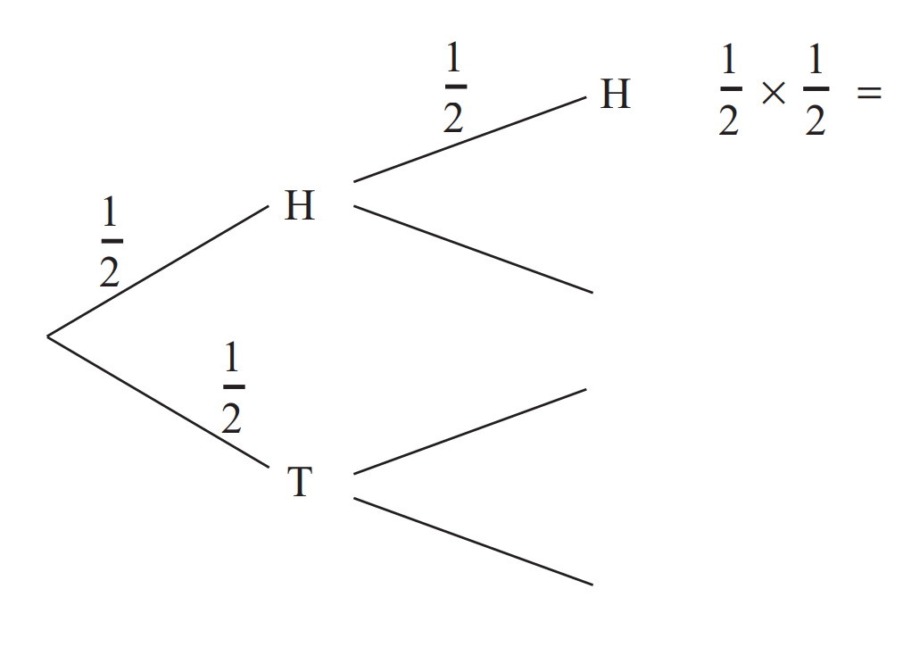




Guided Practice
a) The outcome of the second flip does not depend on what happens in the first flip.
bi) Step 1: Find P(Head) and P(Tail)
P(Head) = $\frac{1}{2}$
P(Tail) = $\frac{1}{2}$
Step 2: Find P(Head, Tail) = $\frac{1}{2}×\frac{1}{2}$
= $\frac{1}{4}$
bii) What are all your options?
P(Head, Tail) and P(Tail, Head)
P(Head and Tail )$=P\left(Head,Tail\right)+P(Tail,Head)$
$$=\frac{1}{4}+\frac{1}{4}=\frac{1}{2}$$

Slide 14
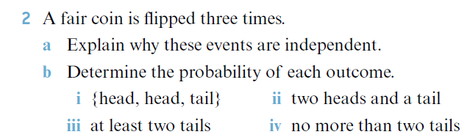
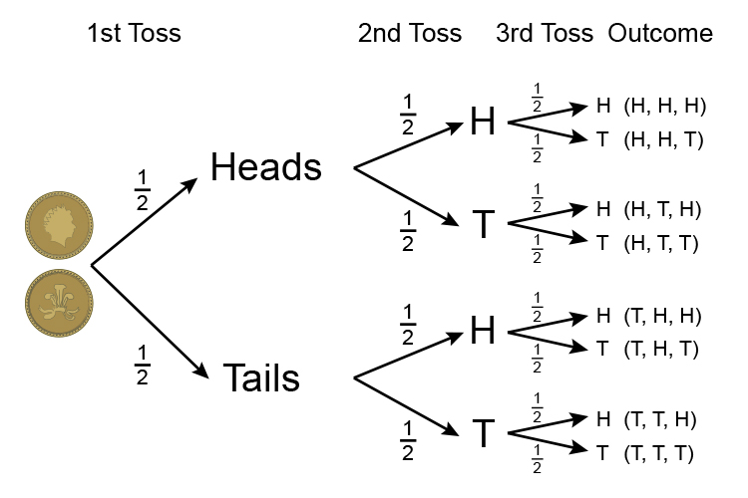




Guided Practice
a) The outcome of the flips does not depend on what happens in the flips before.
P(Head) = $\frac{1}{2}$
P(Tail) = $\frac{1}{2}$
bi) Step 1: Find P(Head) and P(Tail)
Step 2: Find P(Head, Head, Tail):$\frac{1}{2}×\frac{1}{2}×\frac{1}{2}=\frac{1}{8}$
bii) What are all your options?
P(HHT), P(HTH), P(THH)
P(2 heads and a tail )$:\frac{1}{8}+\frac{1}{8}+\frac{1}{8}=\frac{3}{8}$
biii) What are all your options?
P(TTH), P(HTT), P(THT), P(TTT)
P(at least 2 T)$: \frac{1}{8}+\frac{1}{8}+\frac{1}{8}+\frac{1}{8}=\frac{4}{8} =\frac{1}{2}$
biv) Can have 0, 1 or 2 tails. Complement = 3 Heads
P(no more than 2 T)$=1−P(HHH)=\frac{7}{8}$

Slide 15
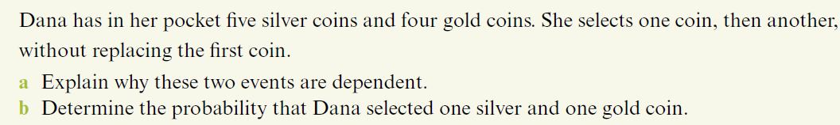

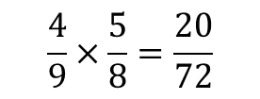



Guided Practice
a) The outcome of the second selection depends on what happens in the first section.
bi) First, find P(Silver on 1st selection) and P(Gold on 2nd selection)
P(Silver on 1st Selection) = $\frac{5}{9}$
P(Gold on 2nd Selection)$=\frac{4}{8}$
P(Silver, Gold)$: \frac{5}{9}×\frac{4}{8}=\frac{20}{72}$
$$\frac{4}{9}×\frac{5}{8}=\frac{20}{72}$$
P(Gold, Silver):
P(One Gold and One Silver) $=$ P(Silver, Gold) + P(Gold, Silver)
$=\frac{20}{72}+\frac{20}{72}$
$=\frac{40}{72}=\frac{5}{9}$

Slide 16
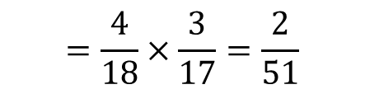



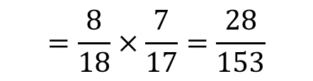
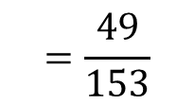

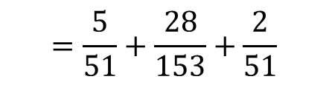
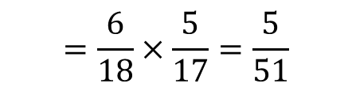

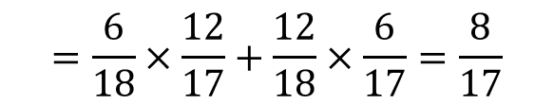
Guided Practice
A drawer contains 6 black socks, 8 red socks, and 4 white socks. If two socks are taken without replacement, find:
P(2 black socks)
P(2 red socks)
P(2 white socks)
P(a pair of socks of matching colours)
P(1 black socks)
a) $P\left(\text{2 }\text{black} \text{socks}\right)$
d) $P\left(\text{pair} \text{of} \text{matching} \text{socks}\right)$
$$=\frac{6}{18}×\frac{5}{17}=\frac{5}{51}$$
$$=\frac{5}{51}+\frac{28}{153}+\frac{2}{51}$$
$$=\frac{49}{153}$$
b) $P\left(\text{2 }\text{red} \text{socks}\right)$
$$=\frac{8}{18}×\frac{7}{17}=\frac{28}{153}$$
e) $P\left(\text{1 }\text{black} \text{sock}\right)$
$$=P\left(\text{1 }\text{black} \text{sock}\text{, }\text{no} \text{black} \text{socks}\right)+P\left(\text{no} \text{black} \text{socks}\text{, 1 }\text{black} \text{sock}\right)$$
c) $P\left(\text{2 }\text{white} \text{socks}\right)$
$$=\frac{6}{18}×\frac{12}{17}+\frac{12}{18}×\frac{6}{17}=\frac{8}{17}$$
$$=\frac{4}{18}×\frac{3}{17}=\frac{2}{51}$$

Slide 17
Independent Practice
Independent Practice
Pearson Ex 10.5 Q 1 to 10

